Slide 1
Monocots I
Monocots except for Commelinoid Clade
Judd et al pp 263-323

Slide 2
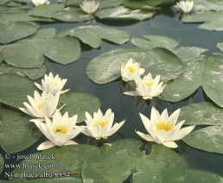
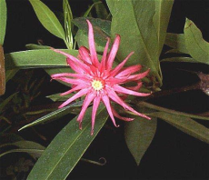
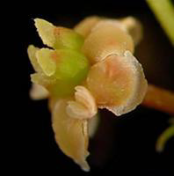
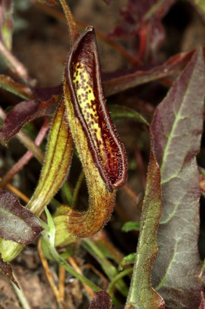
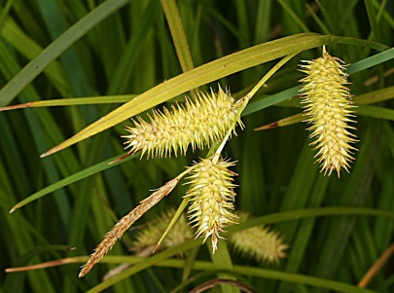
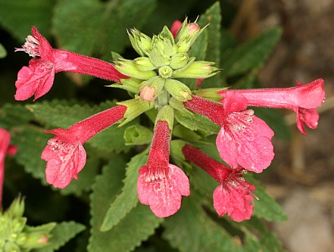
Amborella
Nymphaeales
Austrobaileyales
Monocots
Magnoliids
Eudicots
ANA Grade
Remember the big picture….
Angiosperm Relationships
(simplified)

Slide 3
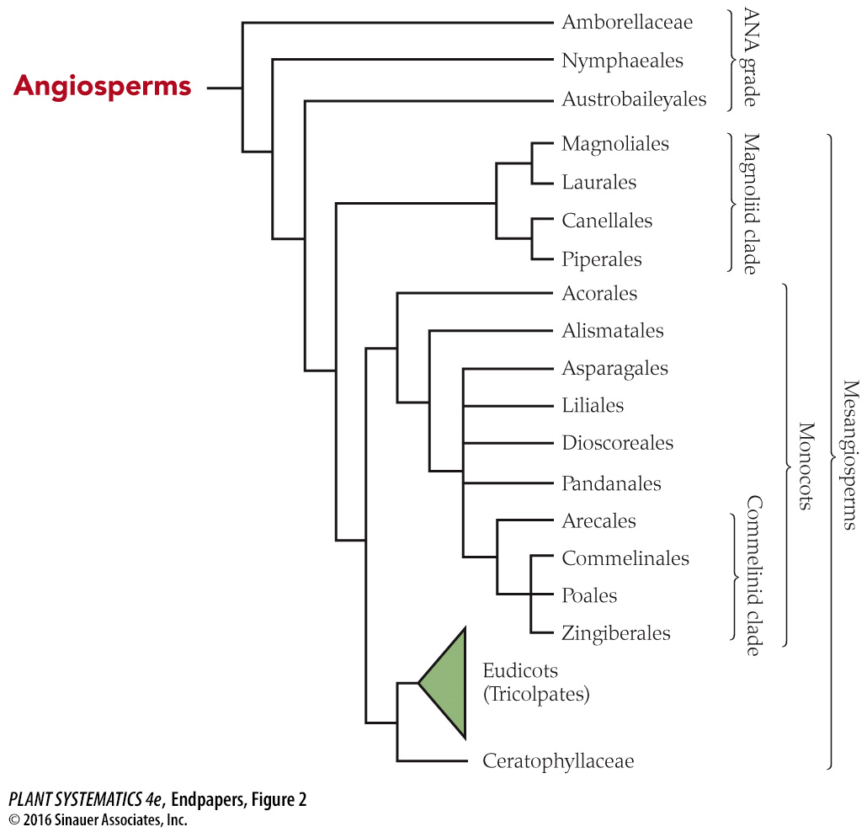
*
*

Slide 4
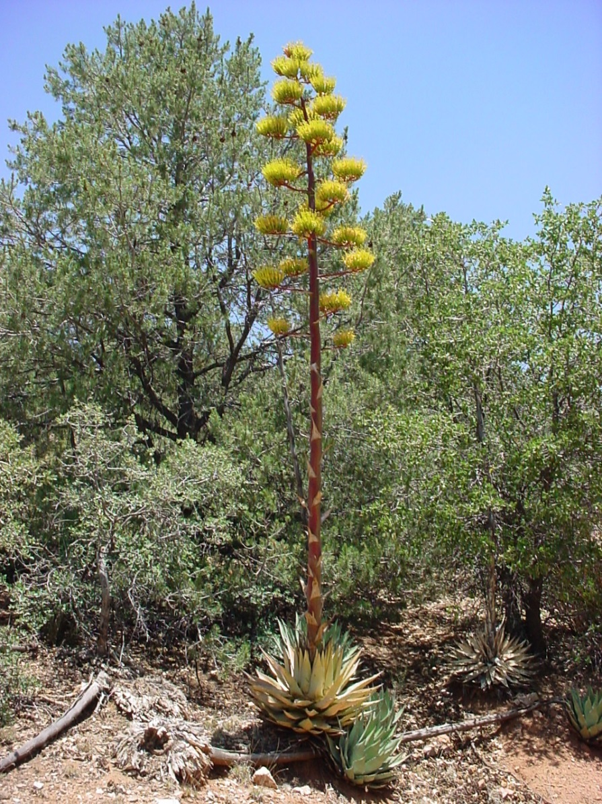
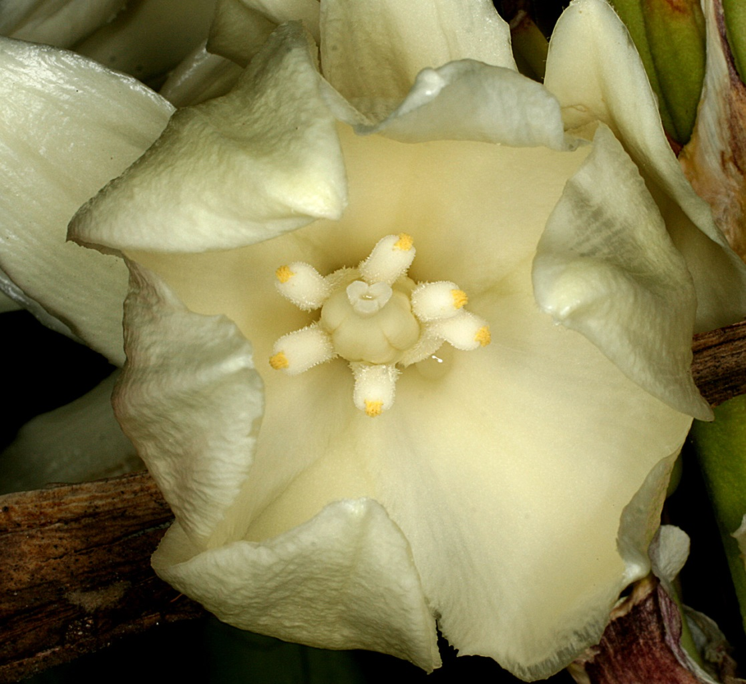
Monocot Diversity
Yucca baccata
Agave parryi

Slide 5
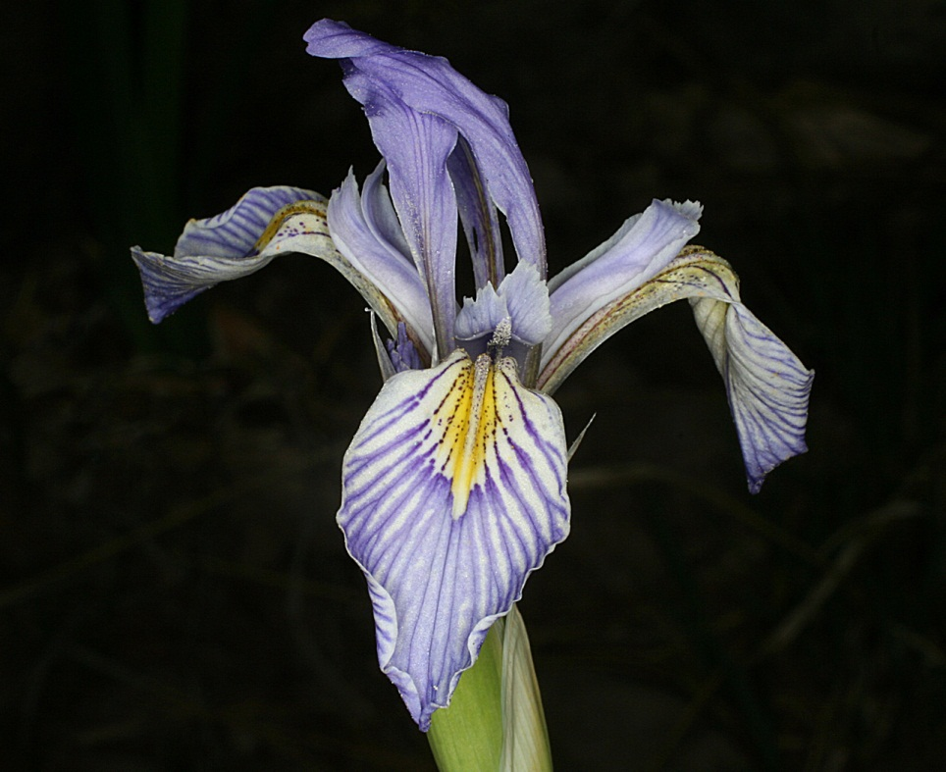
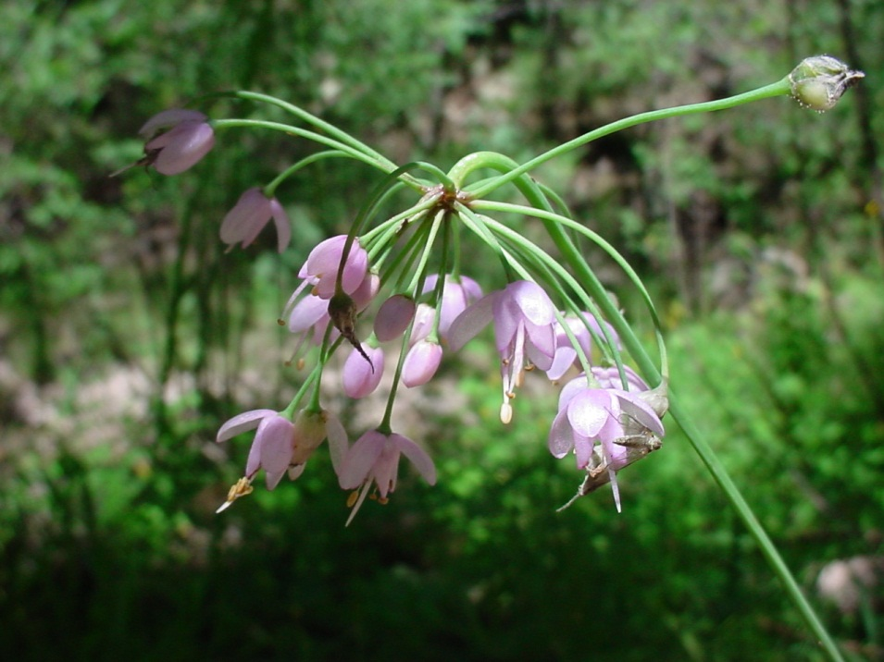
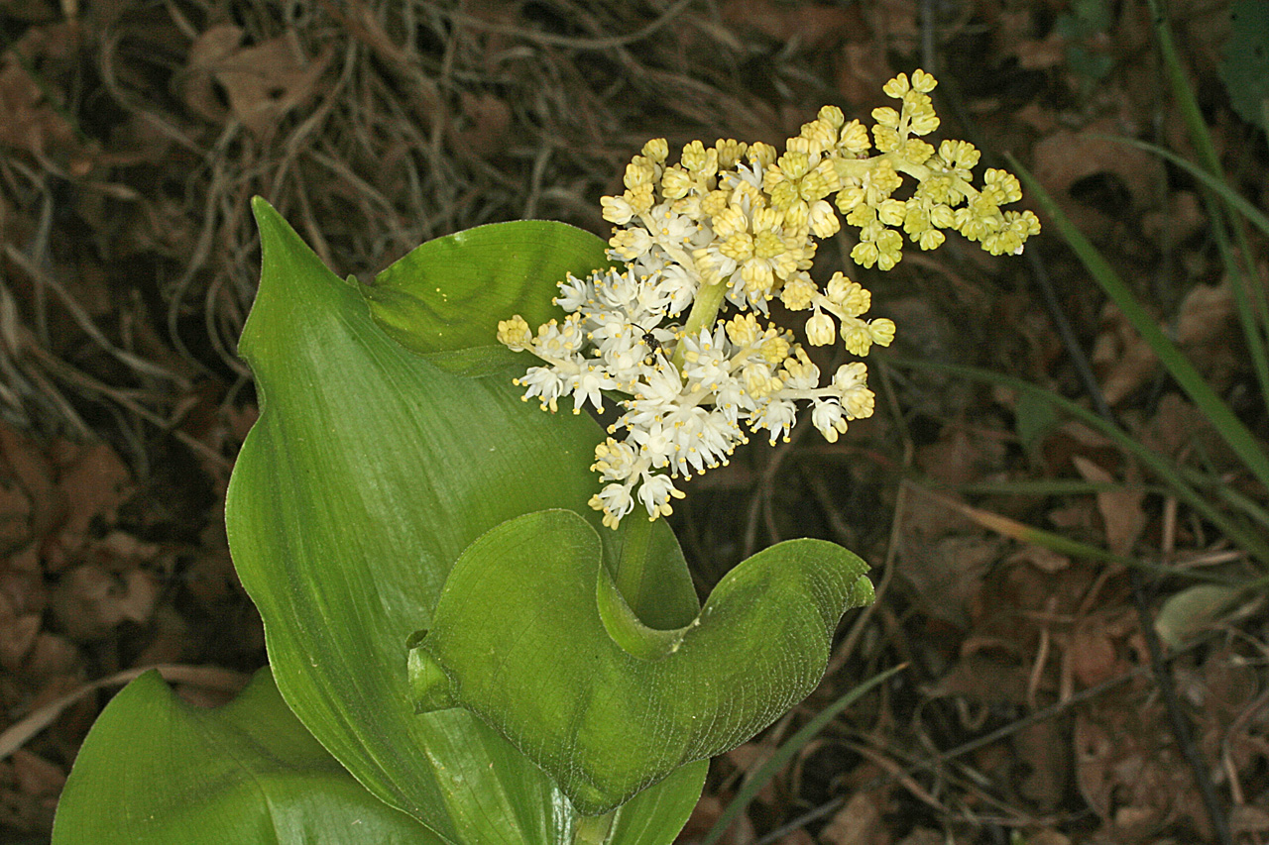
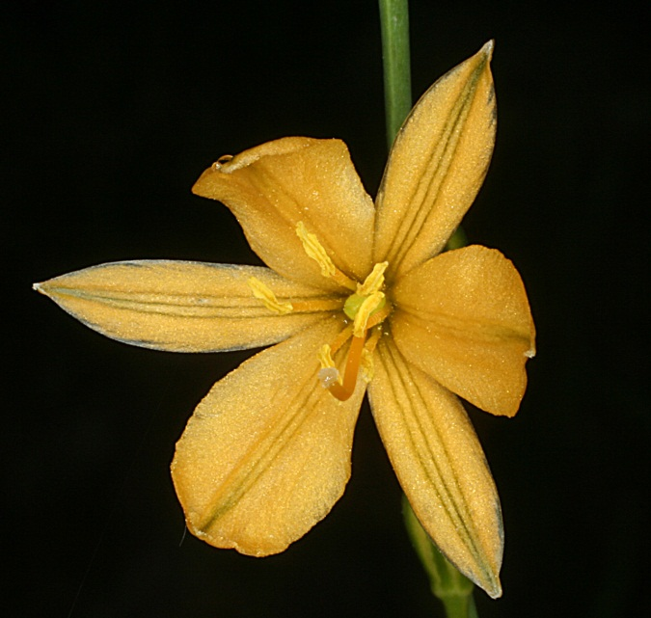
Iris missouriensis
Allium cernuum
Echeandia flavescens
Maianthemum racemosum

Slide 6
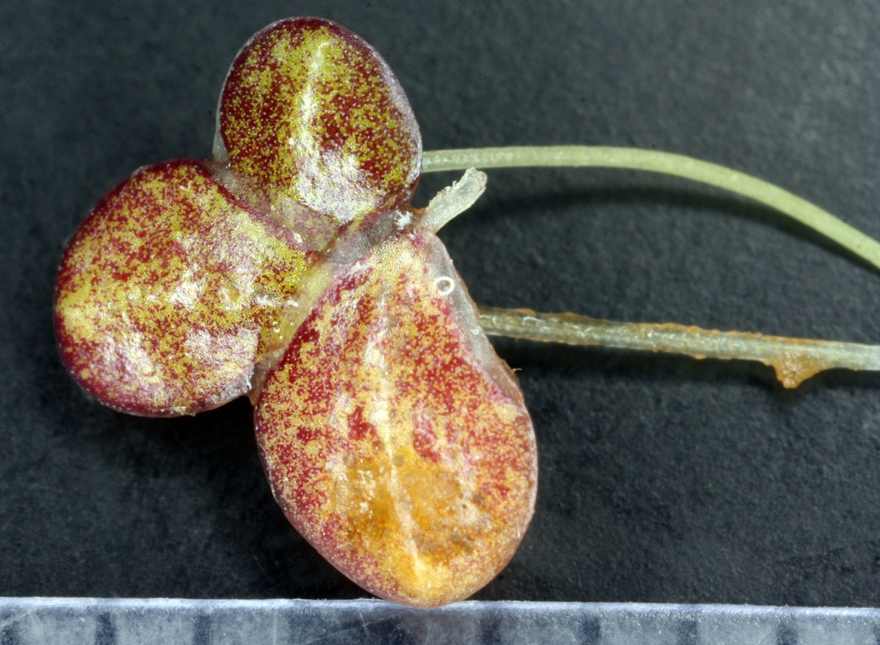
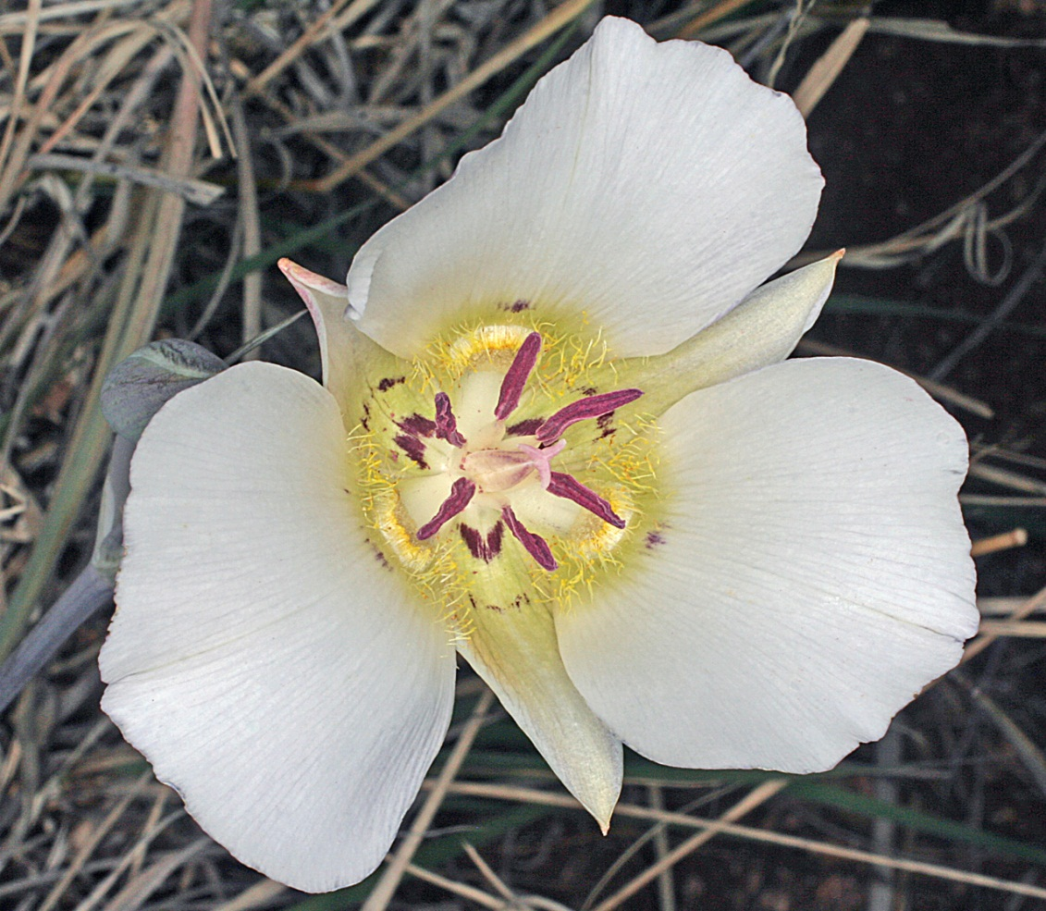
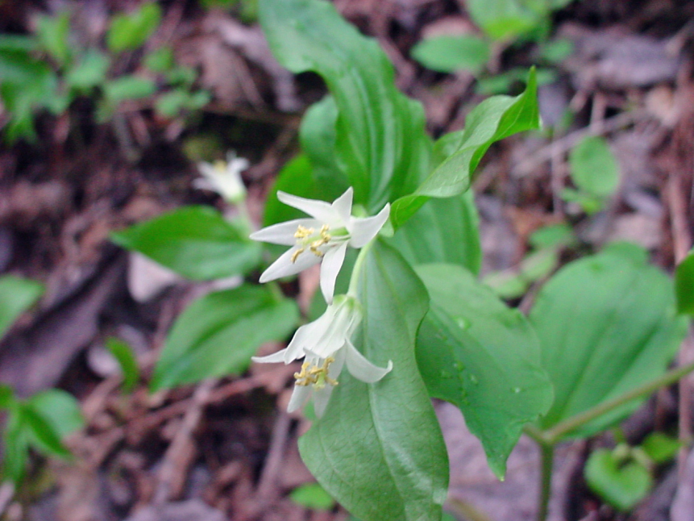
Almost all that’s left in old Liliaceae in our area
Lemna gibba
Prosartes trachycarpum
Calochortus ambiguus

Slide 7
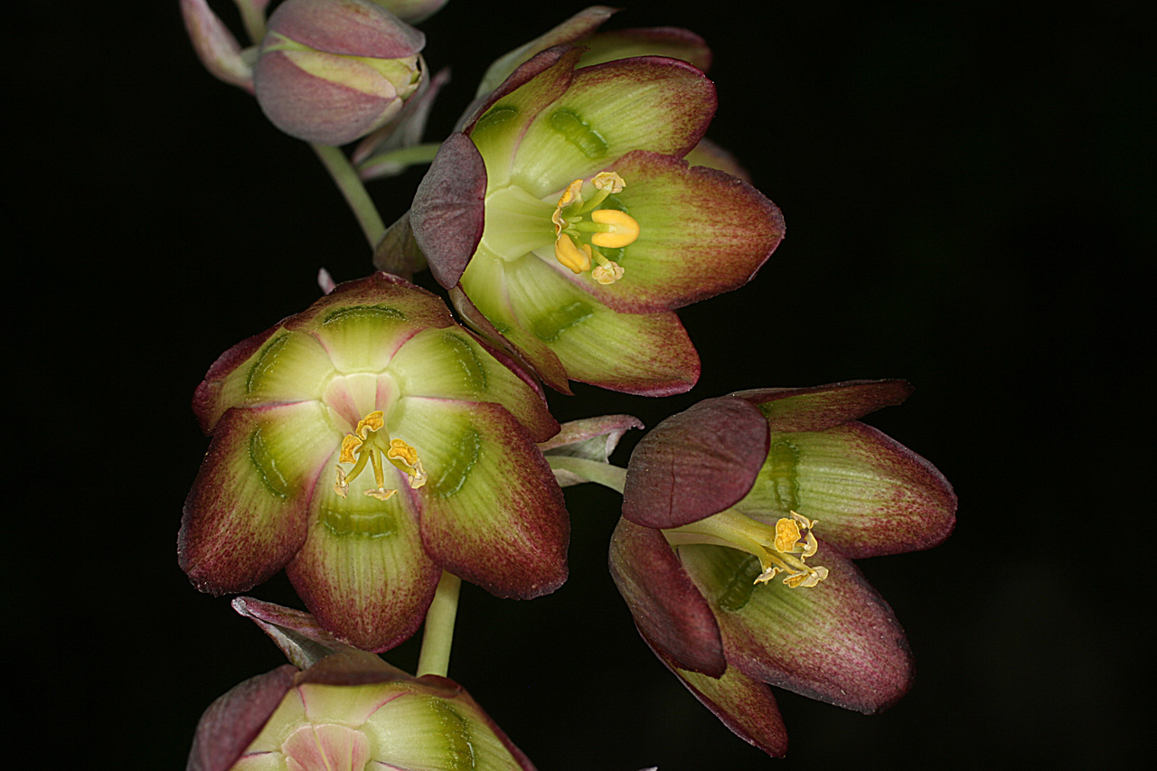
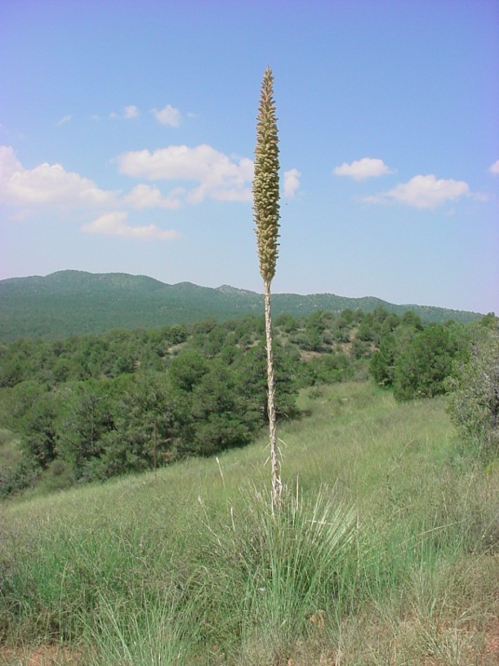
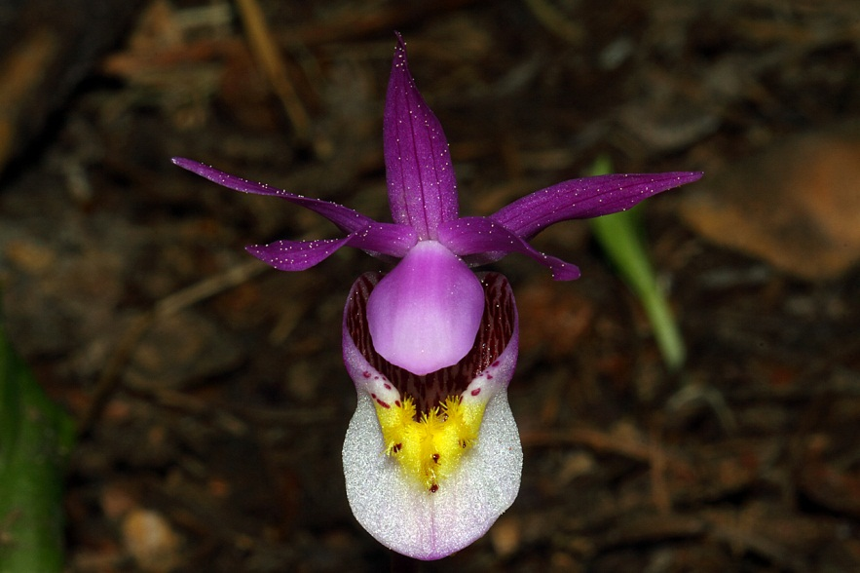
Recently discovered in the Mogollon Mountains by Bob Sivinkski!
Anticlea mogollonensis
Calypso bulbosa
Dasylirion wheeleri

Slide 8
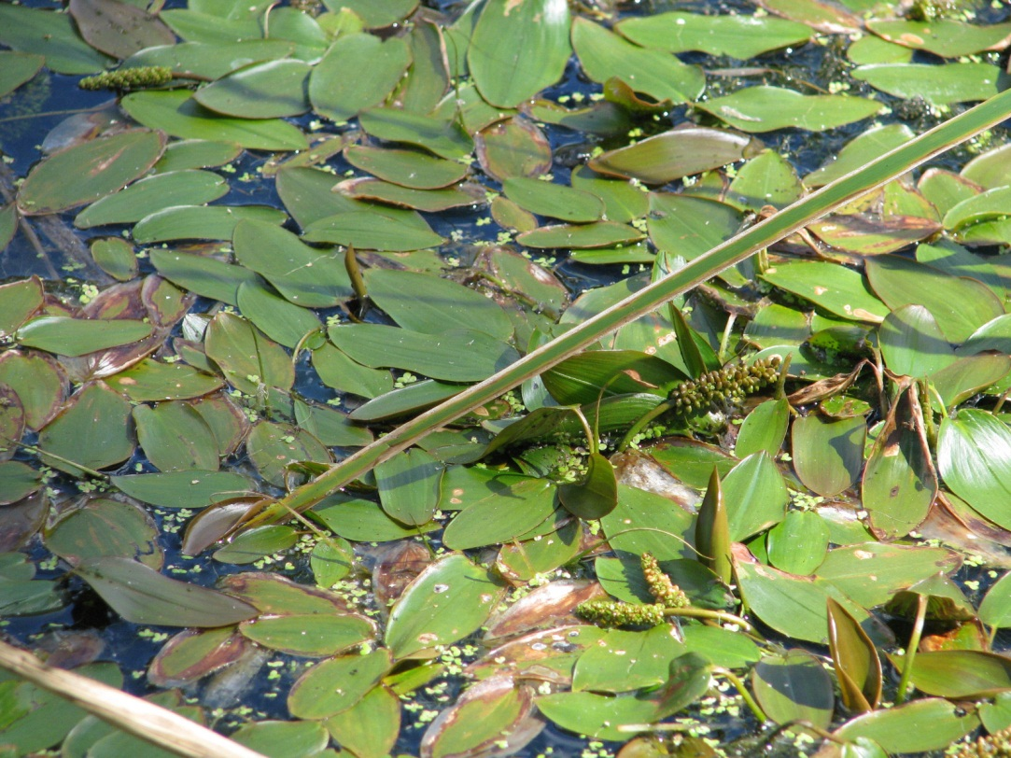
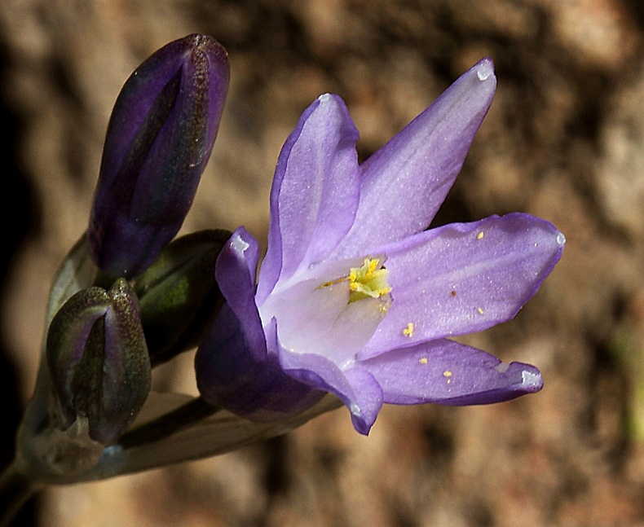
Potamogetons
Dichelostemma capitatum
We have this dizzying amount of diversity within the Monocot clade, and without even including the grasses or other Commelinoids!

Slide 9
Monocot Synapomorphies
Herbaceous habit (but some i.e. Yucca have anomalous meristems and “woody”)
Parallel veined leaves with a sheathing base (some have reticulate venation patterns= reversals)
Embryo with a single cotyledon– remains the best morphological synapomorphy of monocots
Scattered vascular bundles
Fibrous roots (no tap root)

Slide 10
Monocot Synapomorphies
Leaves formed from the basal end of the leaf primordium (intercalary meristem) rather than the apical end as in non-monocots– this is why grass can grow back after you mow your lawn!
Monosulcate pollen (may be pleisiomorphic state– predated this clade)
DNA sequence evidence

Slide 11
Monocot Characters (some may be symplesiomorphic)
Feature | In monocots | In eudicots
Number of parts of each flower (merosity) | in threes (flowers are trimerous) | in fours or fives (tetramerous or pentamerous)
Number of furrows or pores in pollen | one | three
Number of cotyledons (leaves in the seed) | one | two
Arrangement of vascular bundles in the stem | scattered | in concentric circles
Roots | are fibrous | develop from the radicle (i.e., commonly taprooted)
Arrangement of major leaf veins | parallel | reticulate

Slide 12
Monocots: Helpful ID character, though not synapomorphic– probably predated this clade
Plant parts in 3’s (instead of 4’s or 5’s as in eudicots)

Slide 13
Parallel Veined Leaves with Sheathing Base

Slide 14
What is a Cotyledon?? How is it Different from Endosperm?
A cotyledon is (usually) diploid tissue. It is a “leaf, or one of two or occasionally more leaves developed at the first node of the embryo.” They absorb nutrients from the endosperm. J&C pg. 570
“Seed leaf”
Endosperm is usually triploid nutritive tissue for the embryo. It is slowly absorbed by the embryo (including cotyledons) as it grows.

Slide 15
Single Cotyledon– Best Synapomorphy for Monocots

Slide 16
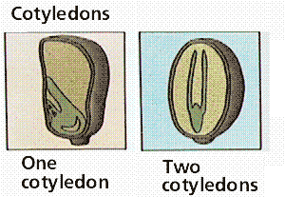
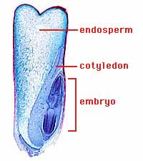
Single Cotyledon– Best Synapomorphy for Monocots
Eudicots
Zea (corn)

Slide 17
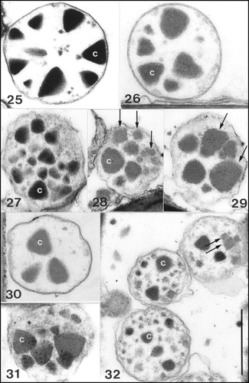
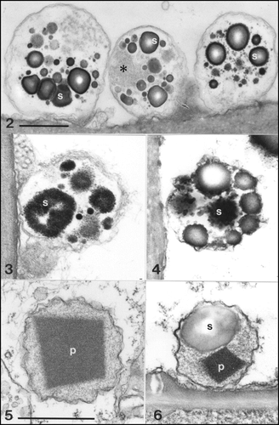
Sieve Cell Plastids Plastids are the site of manufacture and storage of important chemical compounds used by the cell. There are lots of different kinds of plastids.
Cuneate Protein Crystals in Monocot Sieve Cell Plastids
Non-cuneate Protein Crystals in Sieve Cell Plastids of Amborella and Aristolochia

Slide 18
Scattered Vascular Bundles

Slide 19
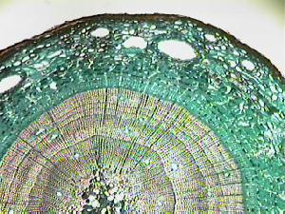
MONOCOT SYNAPOMORPHIES
NO VASCULAR CAMBIUM!

Slide 20
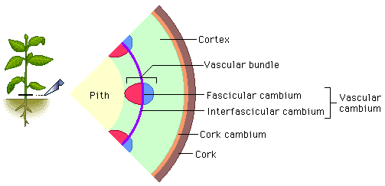
(Eudicot Secondary Growth)
NOT in monocots

Slide 21
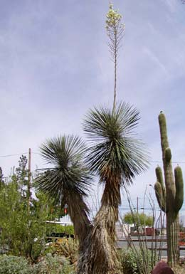
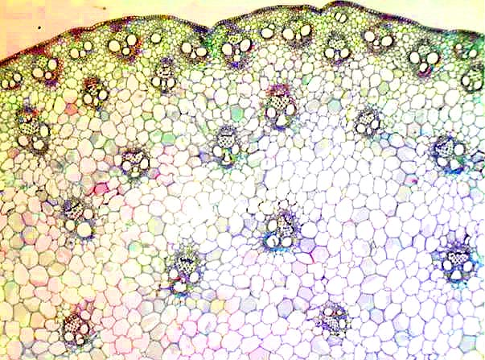
Anomalous Secondary Growth in Monocots
Only certain genera such as Yucca & Agave
\
Secondary Thickening Meristem
Notes:
Vascular Bundles, Parenchyma produced Centripetally
Parenchyma produced Centrifugally

Slide 22
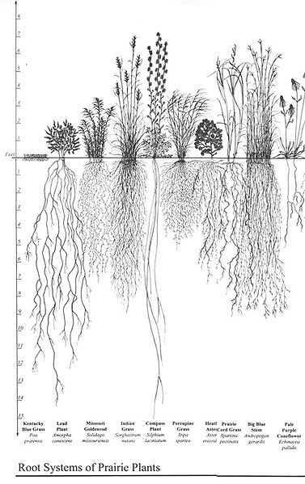
Fibrous Roots
No taproot.

Slide 23
Fibrous Roots
Carex, a monocot genus, with fibrous roots
Dr. William R. Norris at Engeldinger Marsh, Iowa

Slide 24
Most of old Liliaceae now in Asparagales

Slide 25
Relationships in Current Liliales
Also including Veratrum & Anticlea

Slide 26
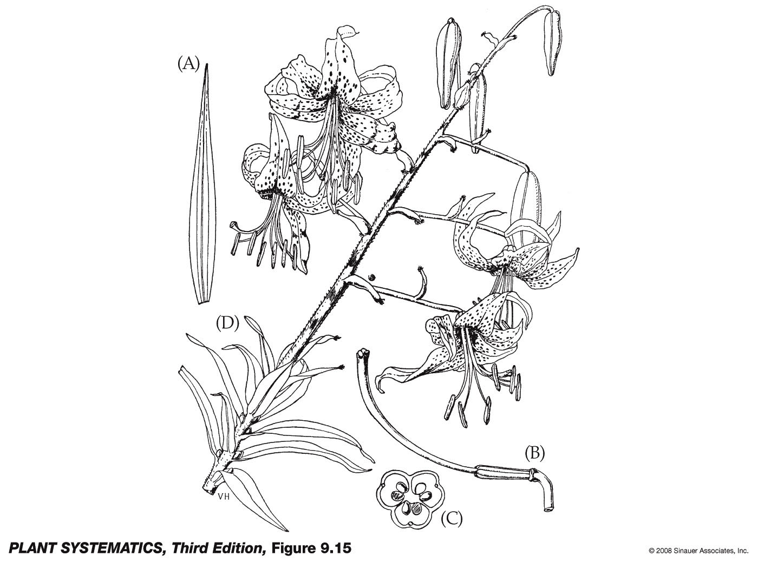
Liliales: Liliaceae
Difficult to diagnose morphologically

Slide 27
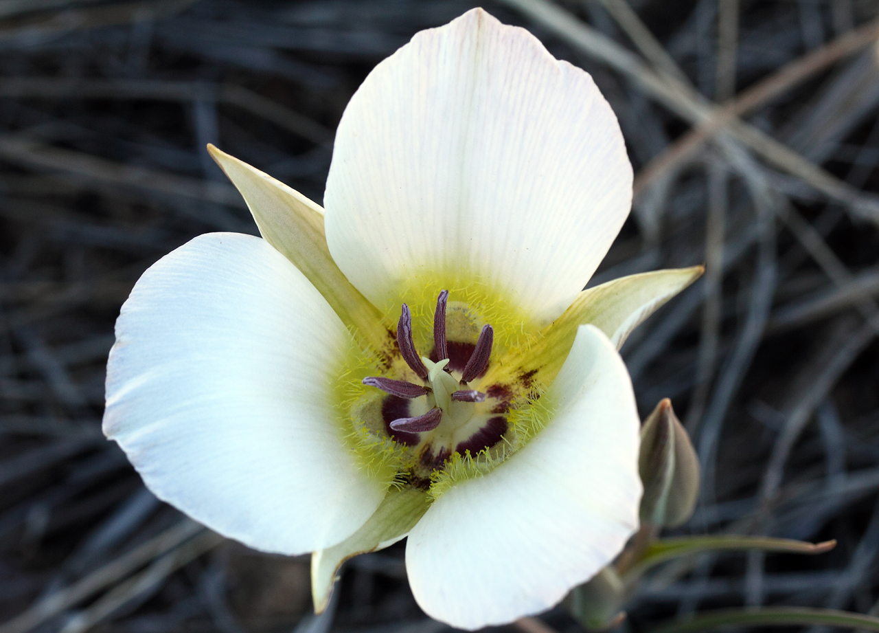
Liliales: Liliaceae: Calochortus

Slide 28
Liliales: Liliaceae: Prosartes

Slide 29
Liliales: Liliaceae
Foliage--
Bulbs or rhizomes, parallel venation
Calyx--
6 tepals
Corolla--
( 6 tepals)
Androecium--
6 stamens, filaments distinct
Gynoecium--
3 connate carpels, ovary superior
Fruit--
Loculicidal capsule

Slide 30
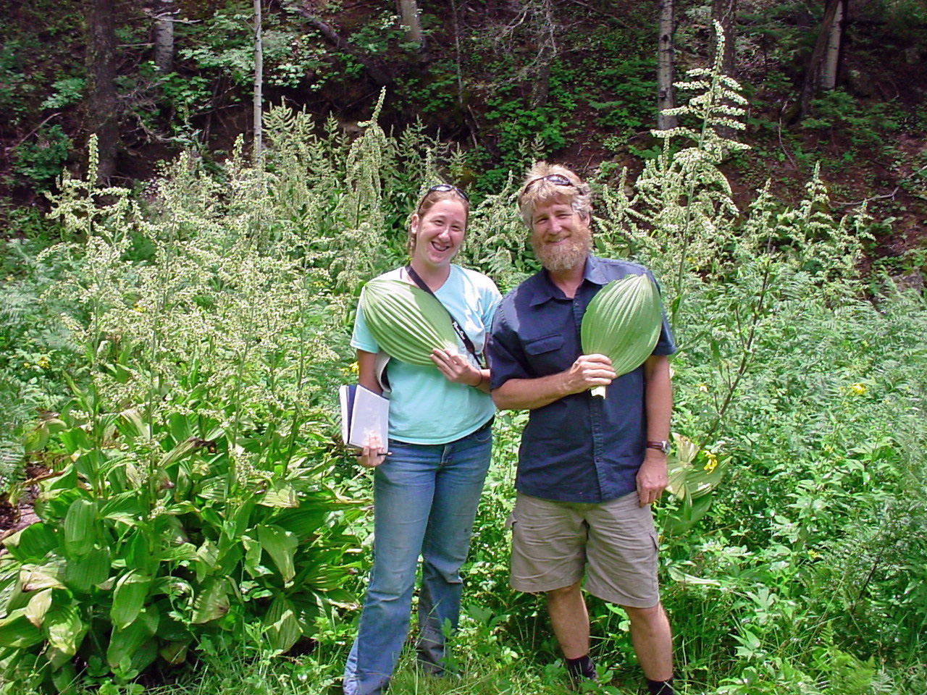
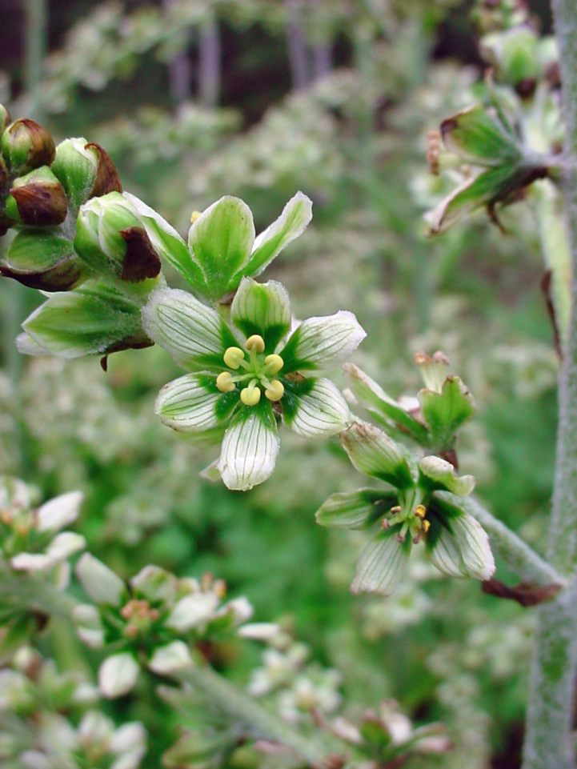
Liliales: Melanthiaceae: Veratrum californicum
Birth defects in sheep grazing on Veratrum californicum provided key insights into developmental biology in the 20th century: Embryonic parts do not develop properly because of malfunctioning of the Hedgehog signalling pathway. (Hedgehog is the name of the signalling molecule)

Slide 31
Liliaceae: Melanthiaceae: Veratrum californicum
Fruit is a capsule.

Slide 32
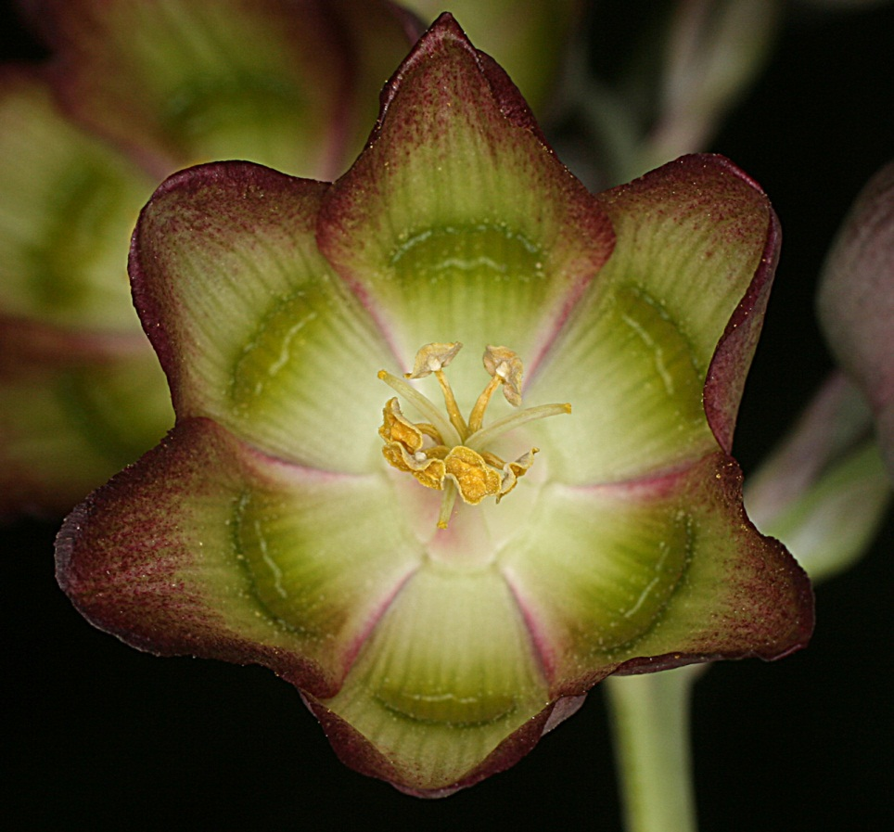
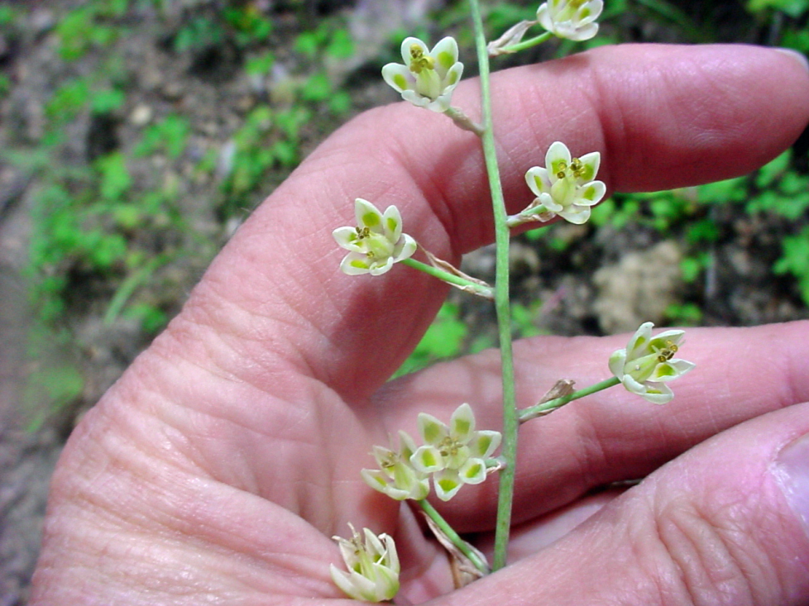
Liliales: Melanthiaceae: Anticlea mogollonensis & Anticlea virescens
Anticlea mogollonensis
Anticlea virescens
Causes death in livestock; Native Americans avoided it; people are poisoned by it when it is confused with onions

Slide 33
Liliales: Melanthiaceae: Anticlea mogollonensis & Anticlea virescens
Grass like leaves

Slide 34
Liliales: Melanthiaceae
Various toxic alkaloids present
Grass-like leaves,
ovate in Veratrum
Alkaloid= chemical compound not involved in primary metabolic pathways (e.g., photosynthesis or glycolysis) and synthesized from amino acids

Slide 35
Liliales: Melanthiaceae
poisonous alkaloids often present (hence the “Death Camas Family”!)
Foliage—
Calyx—
Corolla—
Androecium—
Gynoecium—
Fruit—
6 mostly distinct tepals
usually 6 distinct stamens
3-10 connate carpels, usually 3 distinct styles; superior to slightly inferior
Capsule

Slide 36
Asparagales

Slide 37
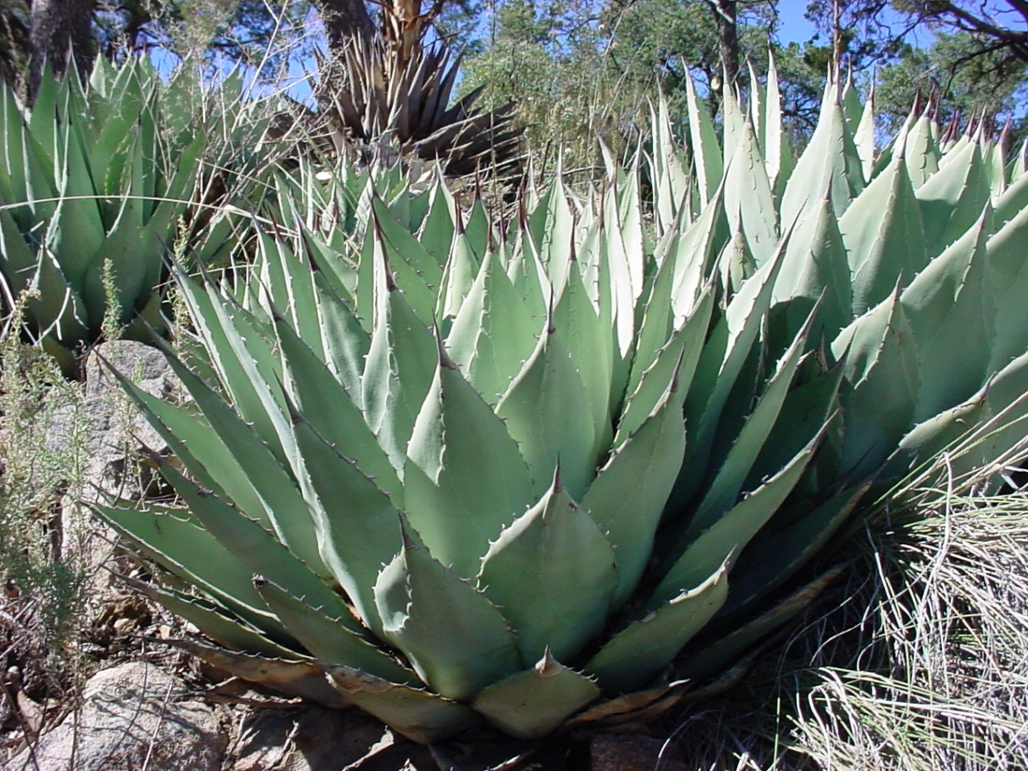
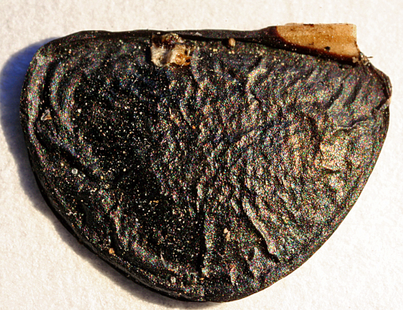
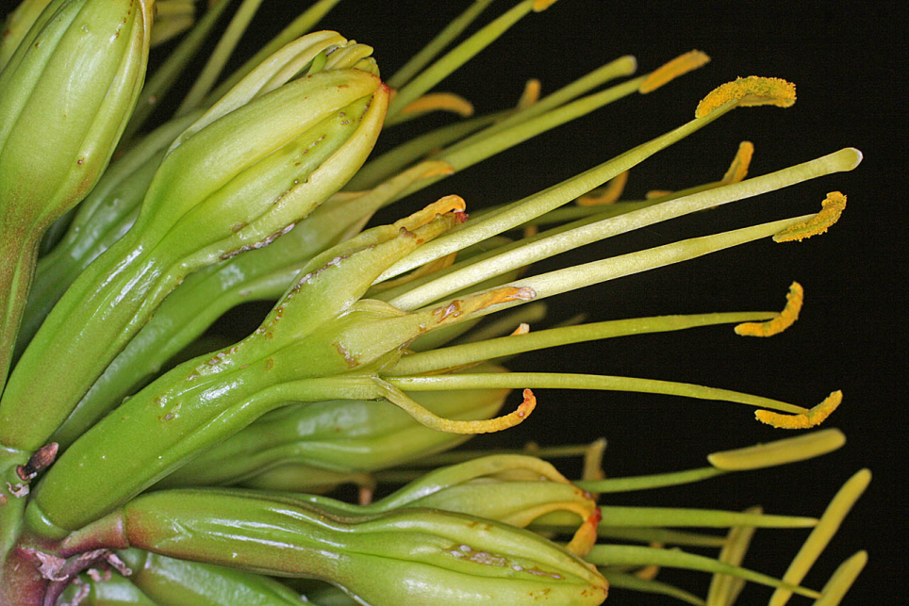
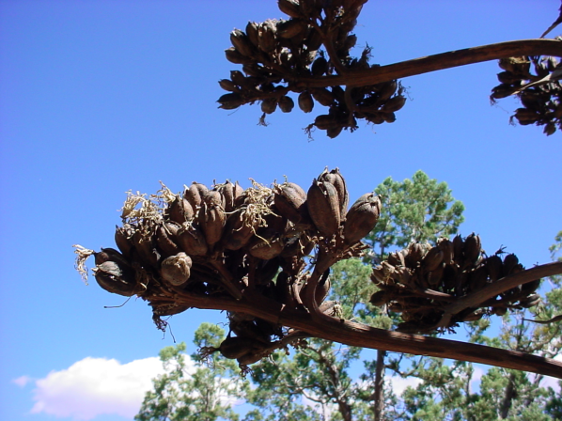
Asparagales: Agavaceae
Agave parryi
Phytomelan
Toothed leaves
Inferior ovary
Capsule

Slide 38
Asparagales: Agavaceae Phytomelan
“The black substance has exceptional resistance against soluble and destroying medium. It can withstand concentrated acids and alkalis, is insoluble in water and organic solvents tested and is highly resistant against bacterial decay as well as destruction by insect pests. The chemical nature of this substance is still not clear. “
CURRENT SCIENCE, VOL. 80, NO. 8, 25 APRIL 2001
“Appears to be a polyvinyl aromatic alcohol”– Wikipedia!

Slide 39
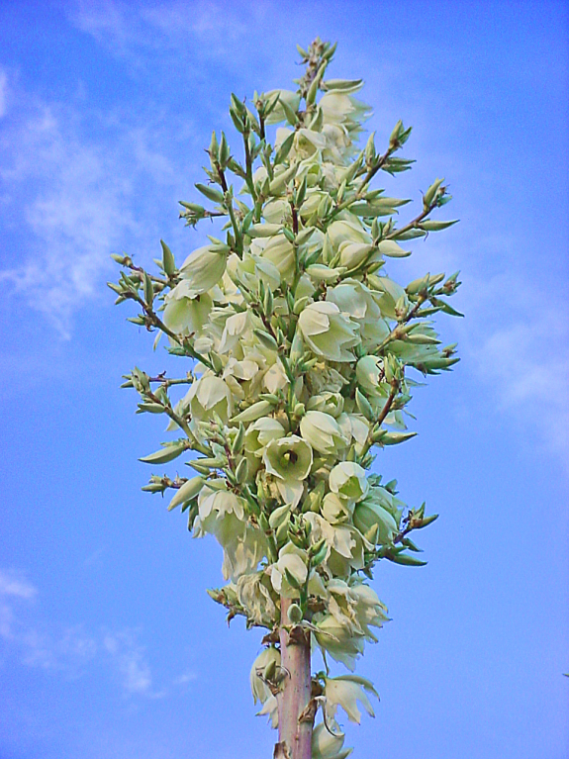
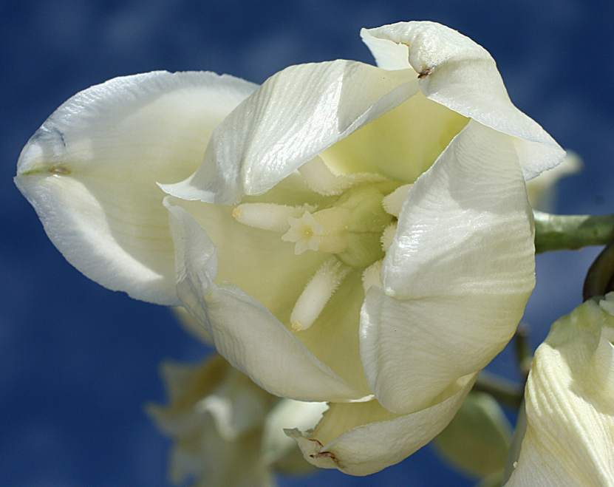
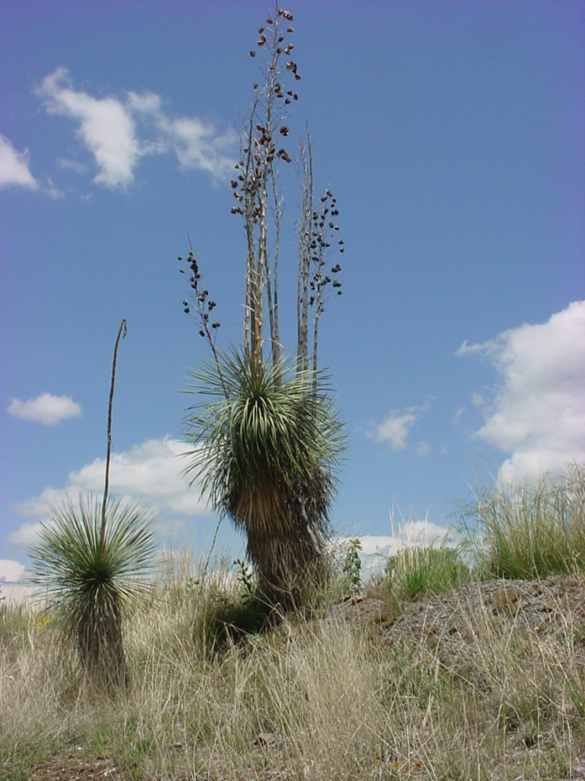
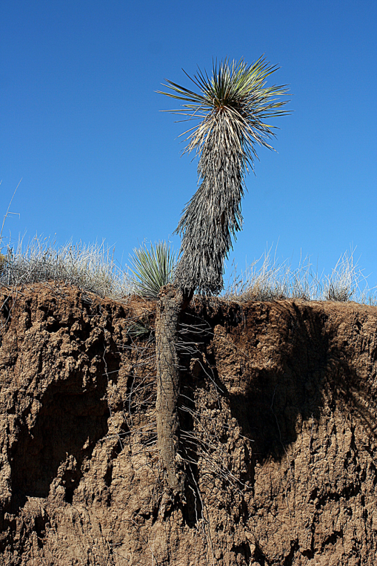
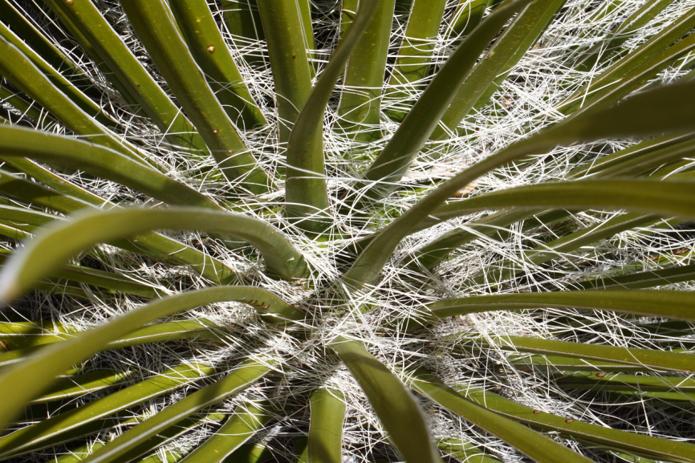
Asparagales: Agavaceae
Superior Ovary
Anomalous secondary growth
Yucca elata
Fibrous leaves

Slide 40
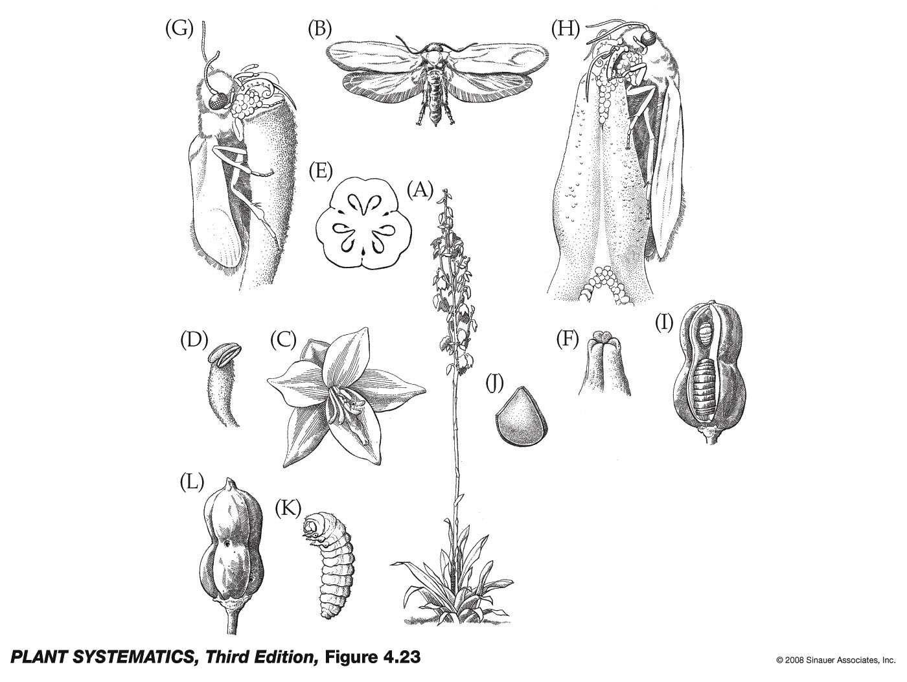
Stuffing pollen into stigmatic cavity and lays eggs among ovules
Female moth gathering pollen with special tentacles, flies to another yucca
Moth larva
Seeds
Pg. 69, J&C– pollination of Yucca by Tegiticula yuccasella.
Fruit with exit holes made by larvae

Slide 41
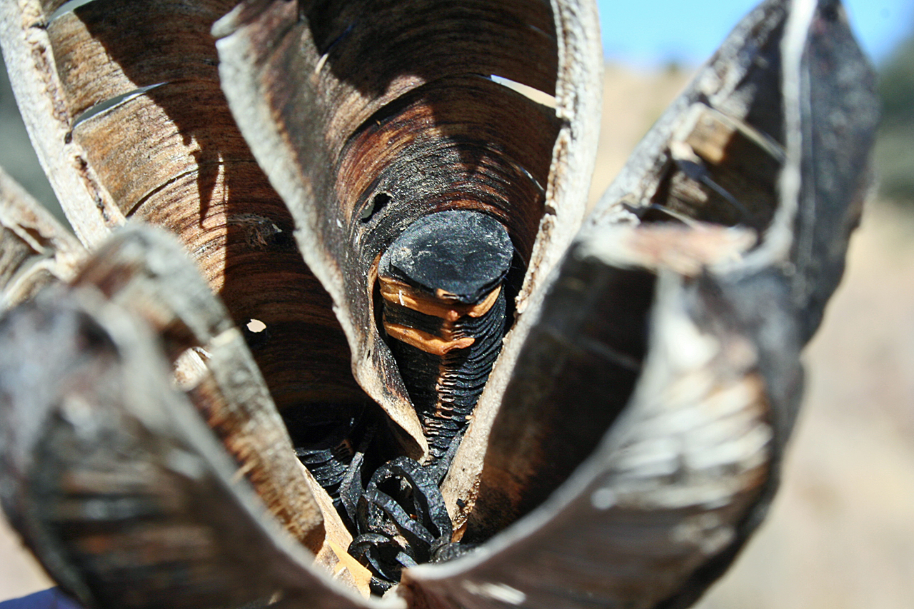
Asparagales: Agavaceae
Loculicidal capsule with 3 locules, seeds covered with Phytomelan– opaque black plant pigment in the seed coat of Agavaceae.
Yucca elata

Slide 42
Asparagales: Agavaceae
leaves smooth with marginal fibers in Yucca; leaves toothed in Agave
Foliage—
Calyx—
Corolla—
Androecium—
Gynoecium—
Fruit—
6 tepals
6 distinct stamens
3 connate carpels; ovary superior in Yucca, inferior in Agave
loculicidal capsule, seeds with black phytomelan crust

Slide 43
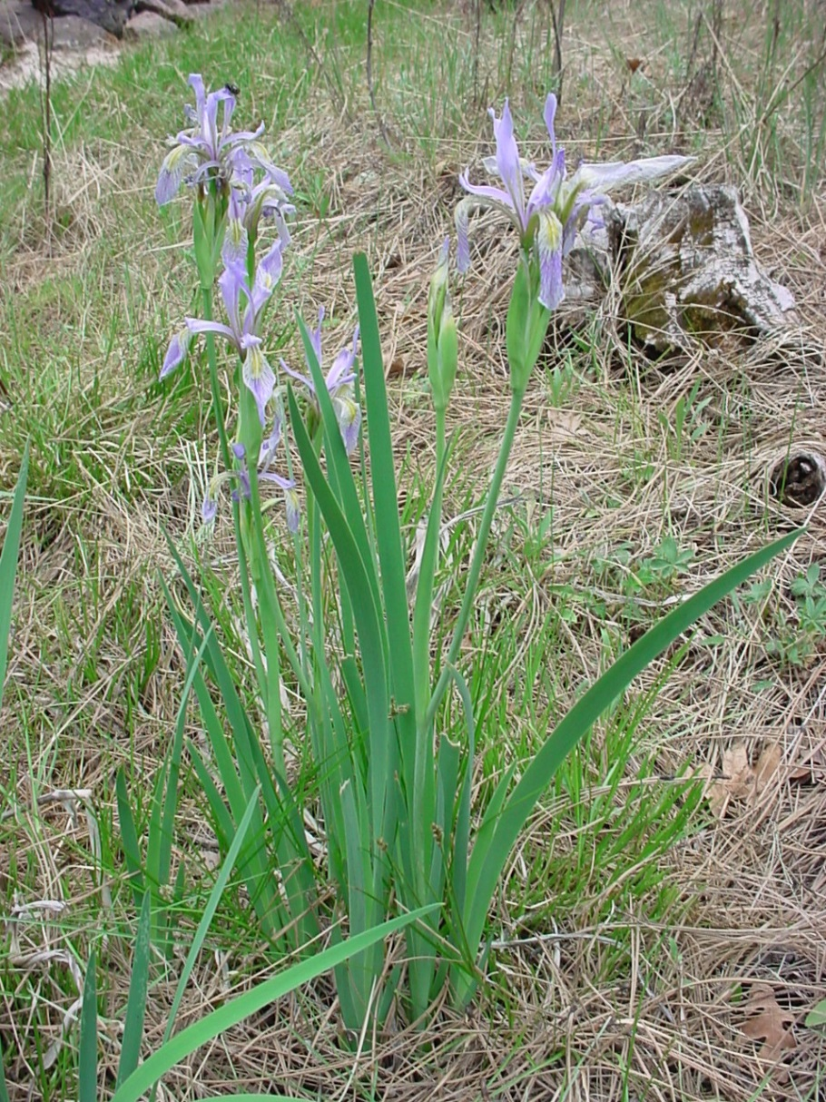
Asparagales: Iridaceae
Equitant leaves: leaf is oriented edgewise to the stem
Conduplicate: folded in half
Iris missouriensis

Slide 44
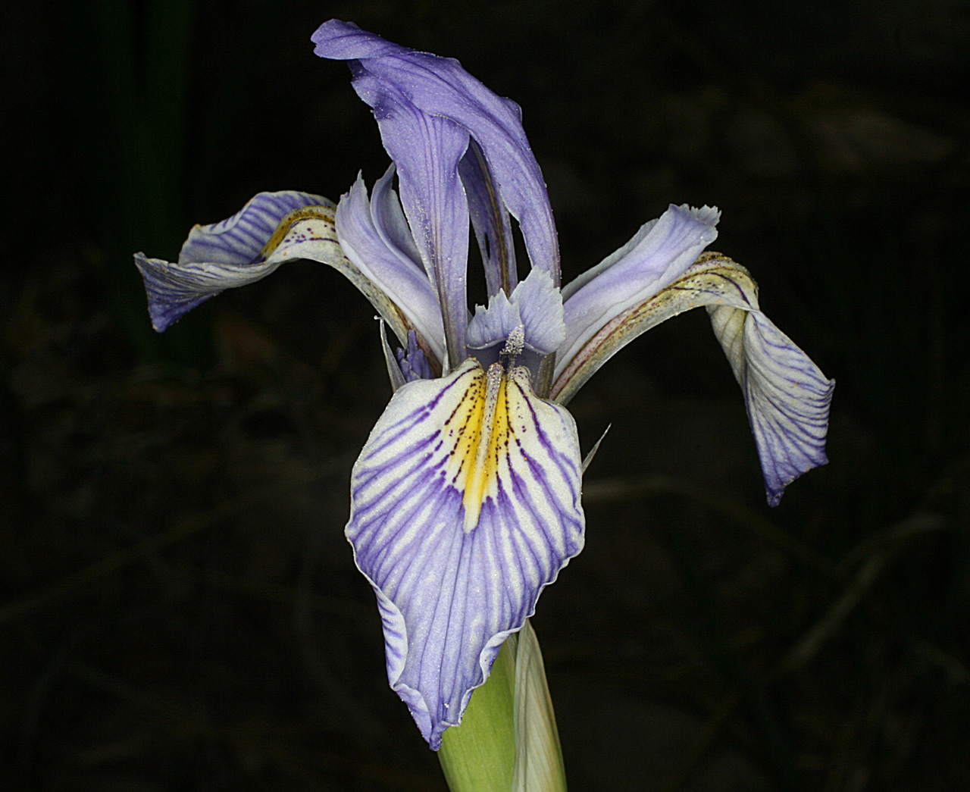
Asparagales: Iridaceae

Slide 45
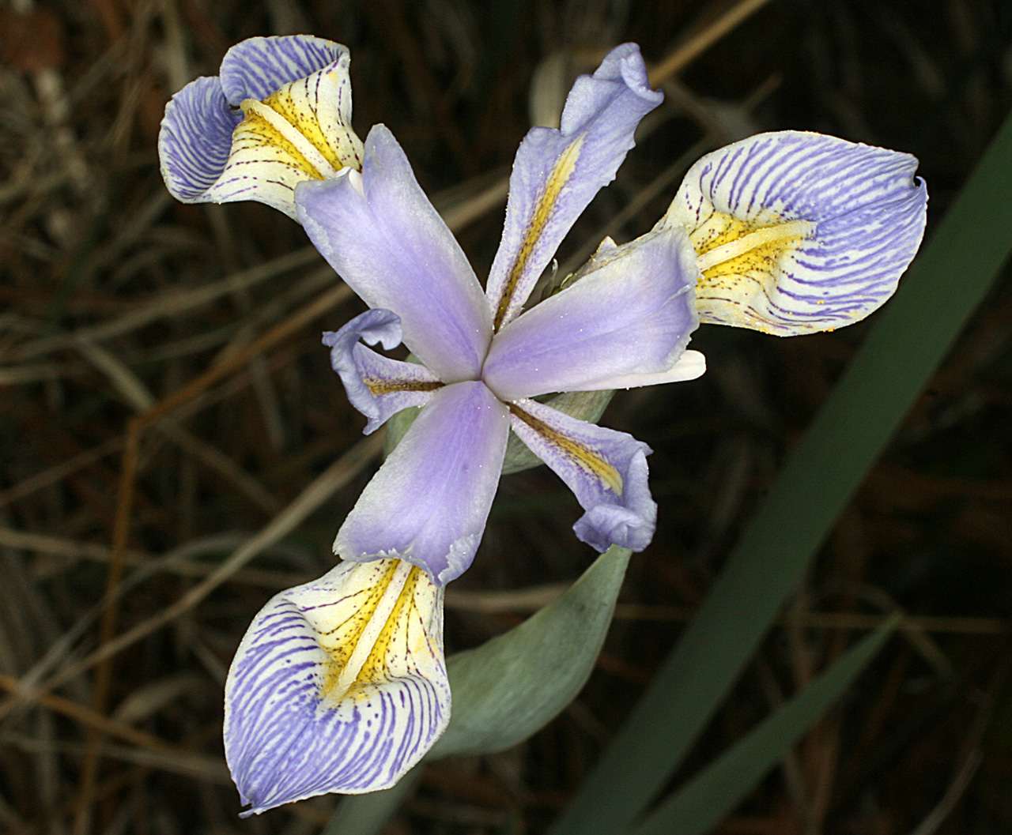
Asparagales: Iridaceae

Slide 46
Asparagales: Iridaceae
Landing Stage

Slide 47
Asparagales: Iridaceae
Loculicidal capsule
Septum

Slide 48
Asparagales: Iridaceae
Equitant & Conduplicate (2-ranked and flattened in the plane of insertion)
Foliage—
Calyx—
Corolla—
Androecium—
Gynoecium—
Fruit—
6 tepals, inner somewhat differentiated from outer
Three distinct filaments, specialized pollination anatomy
Three connate carpels, inferior ovary
Loculicidal capsule

Slide 49
Asparagales: Orchidaceae
Cypripedium parviflorum
Goodyera oblongifolia

Slide 50
Malaxis porphyrea
Epipactis gigantea
Platanthera brevifolia
Calypso bulbosa

Slide 51
Asparagales: Orchidaceae
3 sepals
Pollinia on anther cap
3 petals, the middle one different and called the labellum
Stamens and Stigma fused to form the “column”
Corallorhiza maculata

Slide 52
Asparagales: Orchidaceae
68
Pollinium
67

Slide 53
Pseudocopulation– Orchids fool male wasps into pollinating them with no nectar reward

Slide 54
Asparagales: Orchidaceae
Ovary
Ovary Position is Inferior

Slide 55
Asparagales: Orchidaceae
Fruit is a capsule
Seeds are minute and have no endosperm
1mm
Note lack of phytomelan
Platanthera brevifolia

Slide 56
No Endosperm?
Reversal
How is the embryo nourished as it grows?
MYCORRHIZAE

Slide 57
Asparagales: Orchidaceae
Foliage—
Calyx—
Corolla—
Androecium—
Gynoecium—
Fruit—
Roots strongly mycorrhizal, parallel venation and sheathing at the base
6 Tepals, inner 3 and outer 3 somewhat differentiated, one of the inner ones forming the labellum
stamens fused to stigma forming a column; pollen forming masses called pollinia
ovary inferior, 3 carpels, stigma highly modified
capsule/minute seeds; seeds lacking endosperm or phytomelan

Slide 58
Asparagales: other families in the Gila
Convallariaceae: Maianthemum racemosum
Themidaceae: Dichelostemma capitatum
Alliaceae: Allium macropetalum
And others….

Slide 60
Monocots: Alismatales Mostly aquatic plants Includes Potamogetonaceae and Zannichelliaceae and Araceae
Potamogeton foliosus-- fruit an achene or drupe
Zannichellia palustris
Fruits are achenes
Lemna valdiviana
No perianth in Zannichellia

Slide 61
Monocots: Alismatales: Potamogeton
Foliage
Flowers
Perianth differentiated into sepals and petals in Potamogeton

Slide 62
Monocots: Alismatales
varies from linear to broad, often submerged leaves different from floating ones to just a thallus in Lemna
Foliage—
Sepals—
Petals—
Androecium—
Gynoecium—
Fruit–
Petals and sepals both present in Potamogeton, both absent in Zannichellia & Lemna
Flowers unisexual in Zannichelliaceae
Flowers bisexual in Potamogetonaceae
Achene (sometimes a drupe), utricle in Lemna

